Slide 1





GoF & POSA1 Pattern Examples: Part 1
Douglas C. Schmidt
d.schmidt@vanderbilt.edu
www.dre.vanderbilt.edu/~schmidt
Professor of Computer Science
Institute for Software Integrated Systems Vanderbilt University Nashville, Tennessee, USA

Slide 2
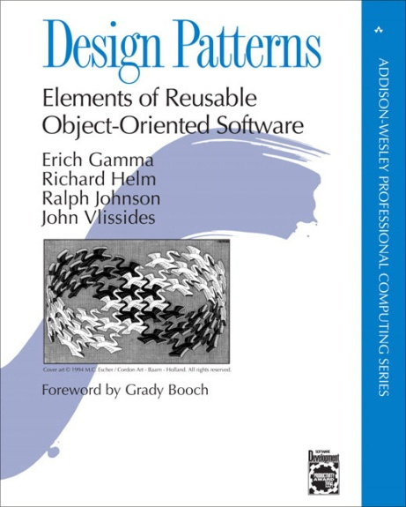
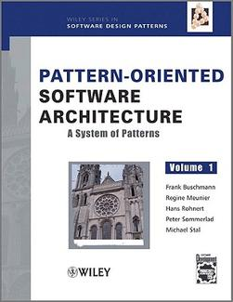
Topics Covered in this Part of the Module
Summarize history & contents of
Design Patterns: Elements of Reusable Object-Oriented Software
Commonly known as the “Gang of Four” (GoF) book
Pattern-Oriented Software Architecture: A System of Patterns
Commonly known as the “POSA1” book

Slide 3

History of the GoF & POSA Pattern Books
1991 Erich Gamma completes his PhD dissertation on patterns for GUIs
See c2.com/cgi/wiki?HistoryOfPatterns for brief history of patterns
Notes:
Find a Url for “history of patterns”.

Slide 4

History of the GoF & POSA Pattern Books
1991 Erich Gamma completes his PhD dissertation on patterns for GUIs
See c2.com/cgi/wiki?HistoryOfPatterns for brief history of patterns
Notes:
Find a Url for “history of patterns”.

Slide 5
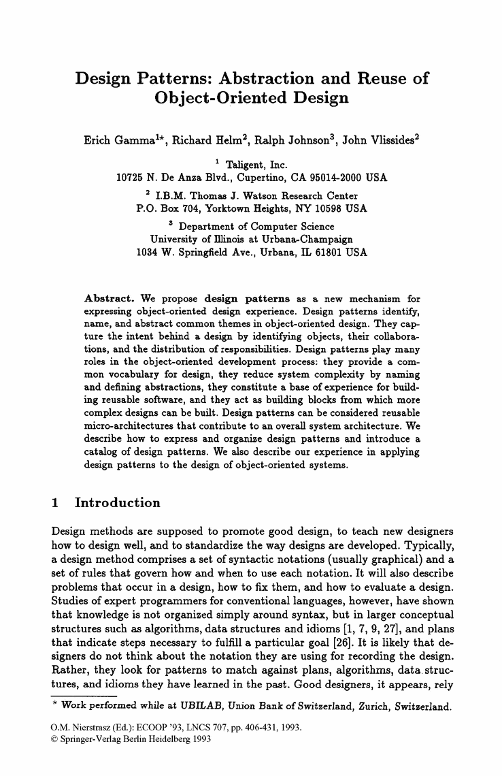
History of the GoF & POSA Pattern Books
1991 Erich Gamma completes his PhD dissertation on patterns for GUIs
1993 GoF publish their first paper on patterns at ECOOP
See c2.com/cgi/wiki?HistoryOfPatterns for brief history of patterns
Notes:
Find a Url for “history of patterns”.

Slide 6

History of the GoF & POSA Pattern Books
1991 Erich Gamma completes his PhD dissertation on patterns for GUIs
1993 GoF publish their first paper on patterns at ECOOP
1994 Design Patterns: Elements of Reusable Object-Oriented Software (GoF book) published
See c2.com/cgi/wiki?HistoryOfPatterns for brief history of patterns
Notes:
Find a Url for “history of patterns”.

Slide 7

History of the GoF & POSA Pattern Books
1991 Erich Gamma completes his PhD dissertation on patterns for GUIs
1993 GoF publish their first paper on patterns at ECOOP
1994 Design Patterns: Elements of Reusable Object-Oriented Software (GoF book) published
1994 First Pattern Languages of Programming (PLoP) conference
See c2.com/cgi/wiki?HistoryOfPatterns for brief history of patterns
Notes:
Find a Url for “history of patterns”.

Slide 8
History of the GoF & POSA Pattern Books
1991 Erich Gamma completes his PhD dissertation on patterns for GUIs
1993 GoF publish their first paper on patterns at ECOOP
1994 Design Patterns: Elements of Reusable Object-Oriented Software (GoF book) published
1994 First Pattern Languages of Programming (PLoP) conference
1996 volume 1 of the Pattern-Oriented Software Architecture (POSA1 book) published
See c2.com/cgi/wiki?HistoryOfPatterns for brief history of patterns
Notes:
Find a Url for “history of patterns”.

Slide 9
History of the GoF & POSA Pattern Books
1991 Erich Gamma completes his PhD dissertation on patterns for GUIs
1993 GoF publish their first paper on patterns at ECOOP
1994 Design Patterns: Elements of Reusable Object-Oriented Software (GoF book) published
1994 First Pattern Languages of Programming (PLoP) conference
1996 volume 1 of the Pattern-Oriented Software Architecture (POSA1 book) published
The GoF & POSA authors worked on their books for many years
They selected design practices that could be recast as patterns, distilled the presentations, culled those deemed immature, etc.
See c2.com/cgi/wiki?HistoryOfPatterns for brief history of patterns
Notes:
Find a Url for “history of patterns”.

Slide 10
Design Space for GoF Patterns
Abstract the process of instantiating objects
Describe how classes & objects can be combined to form larger structures
Concerned with communication between objects
Purpose: Reflects What the Pattern Does
 | Creational | Structural | Behavioral
Class | Factory Method | Adapter (class) | Interpreter Template Method
Object | Abstract Factory Builder Prototype Singleton | Adapter (object) Bridge Composite Decorator Flyweight Façade Proxy | Chain of Responsibility Command Iterator Mediator Memento Observer State Strategy Visitor
Scope: Domain Where Pattern Applies
√
√
See en.wikipedia.org/wiki/Design_Patterns for more about the GoF book

Slide 11
Design Space for GoF Patterns
Although GoF patterns don’t focus much on concurrency & networking they are used extensively when implementing concurrent & networked software
Purpose: Reflects What the Pattern Does
 | Creational | Structural | Behavioral
Class | Factory Method | Adapter (class) | Interpreter Template Method
Object | Abstract Factory Builder Prototype Singleton | Adapter (object) Bridge Composite Decorator Flyweight Façade Proxy | Chain of Responsibility Command Iterator Mediator Memento Observer State Strategy Visitor
Scope: Domain Where Pattern Applies
√
√

Slide 12
Design Space for POSA1 Patterns
Expresses a fundamental structural organization schema for a software system
Provides a scheme for refining components of a software system or the relationships between them
Architecture Patterns | Design Patterns
Layers | Whole-Part
Pipes & Filters | Master-Slave
Blackboard | Proxy
Broker | Command Processor
Model-View-Controller | View handler
Presentation-Abstraction-Control | Forwarded-Receiver
Microkernel | Client-Dispatcher-Server
Reflection | Publisher-Subscriber
√
√
√
See www.dre.vanderbilt.edu/POSA for more about the POSA books

Slide 13
Design Space for POSA1 Patterns
Many POSA1 patterns are relevant for concurrent & networked software
Architecture Patterns | Design Patterns
Layers | Whole-Part
Pipes & Filters | Master-Slave
Blackboard | Proxy
Broker | Command Processor
Model-View-Controller | View handler
Presentation-Abstraction-Control | Forwarded-Receiver
Microkernel | Client-Dispatcher-Server
Reflection | Publisher-Subscriber
√
√
√
√
√
√
√
√
√
√

Slide 14
Summary
The GoF & POSA1 books present multiple patterns in the form of a pattern collection

Slide 15
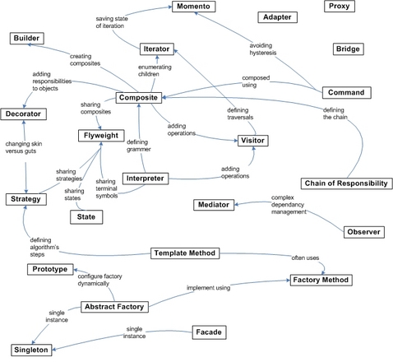
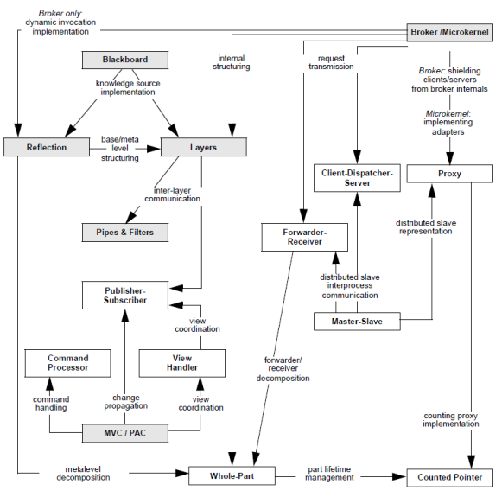
Summary
The GoF & POSA1 books present multiple patterns in the form of a pattern collection
Focus is on stand-alone patterns, rather than on relationships among groups of patterns

Slide 16
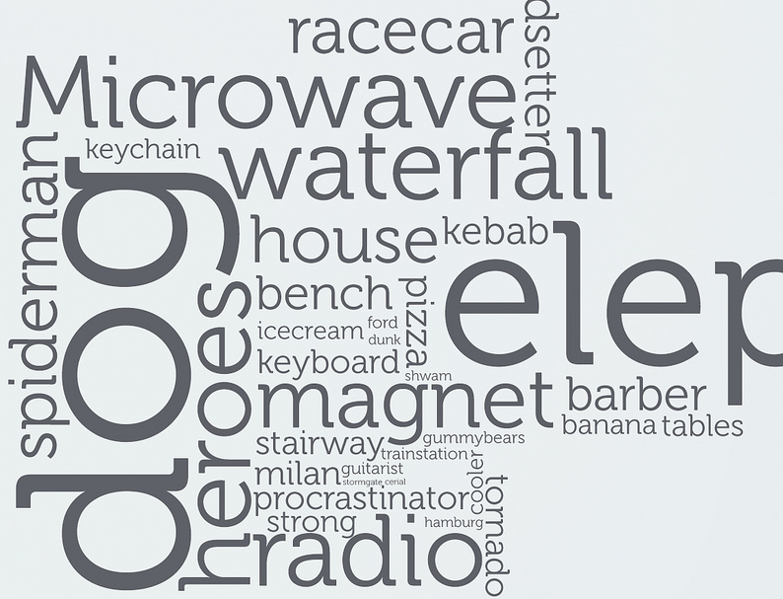
Summary
The GoF & POSA1 books present multiple patterns in the form of a pattern collection
Focus is on stand-alone patterns, rather than on relationships among groups of patterns
Stand-alone patterns provide “point solutions” to relatively bounded problems that arise within specific contexts
They play a role similar to vocabulary words in a human language
Notes:
http://www.flickr.com/photos/24809504@N07/2517411063/

Slide 17
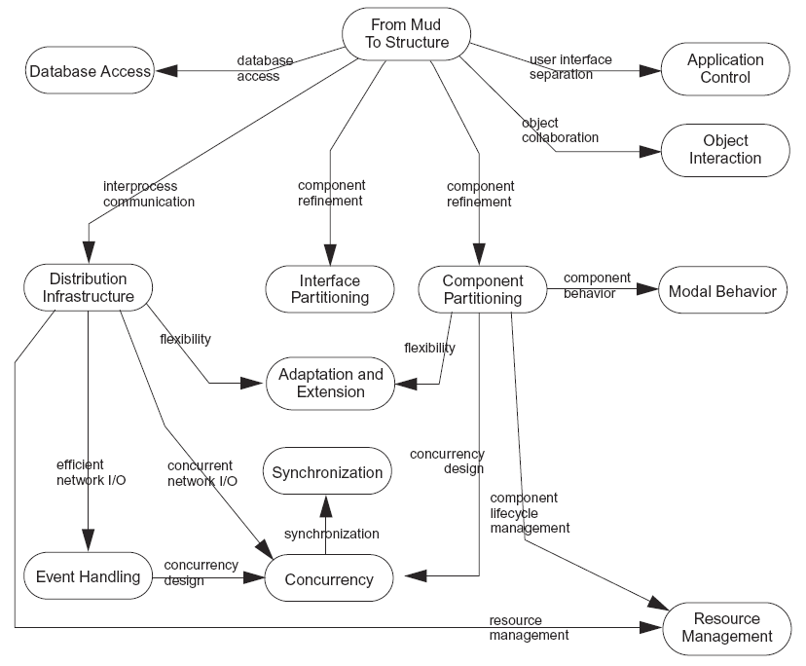
Summary
The GoF & POSA1 books present multiple patterns in the form of a pattern collection
Focus is on stand-alone patterns, rather than on relationships among groups of patterns
Stand-alone patterns provide “point solutions” to relatively bounded problems that arise within specific contexts
They play a role similar to vocabulary words in a human language
Any significant software design includes many patterns
In practice, therefore, a stand-alone pattern is unusual

Slide 18
GoF & POSA1 Pattern Examples: Part 2
Douglas C. Schmidt
d.schmidt@vanderbilt.edu
www.dre.vanderbilt.edu/~schmidt
Professor of Computer Science
Institute for Software Integrated Systems Vanderbilt University Nashville, Tennessee, USA

Slide 19
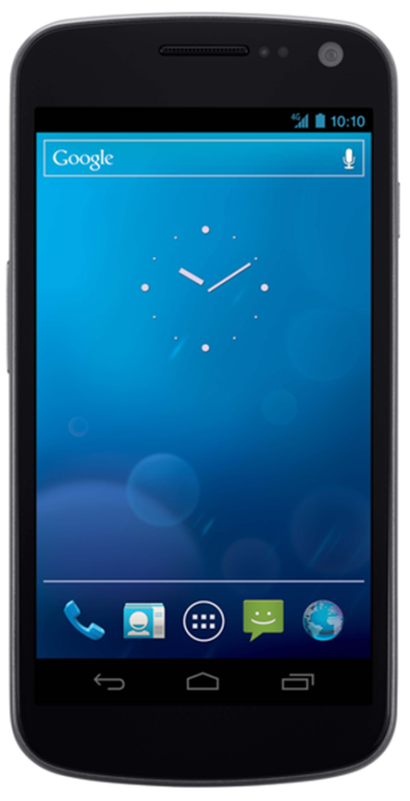
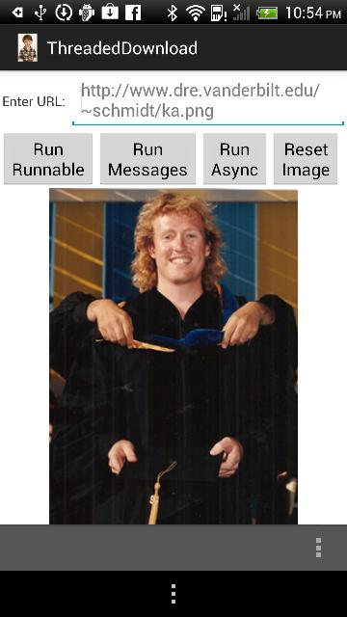
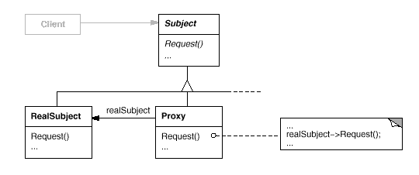
Topics Covered in this Part of the Module
Summarize history & contents of
Design Patterns: Elements of Reusable Software
Commonly known as the “Gang of Four” (GoF) book
Pattern-Oriented Software Architecture: A System of Patterns
Commonly known as “POSA1” book
Example of GoF & POSA1 patterns applied in the context of Android
Proxy

Slide 20
Motivating Example: Android App
The app Activity directs a Service to download images from a web server
1: Activity calls downloadImage() with image URL
Download Service
See www.dre.vanderbilt.edu/~schmidt/cs282 for info on this app

Slide 21
Motivating Example: Android App
The app Activity directs a Service to download images from a web server
The Service caches the images locally in external memory files managed by a Content Provider
1: Activity calls downloadImage() with image URL
Download Service
2: Sends GET request to web server
3: Stores downloaded image in filesystem & metadata in Content Provider
Image Metadata Content Provider
Image Files
See www.dre.vanderbilt.edu/~schmidt/cs282 for info on this app

Slide 22
Motivating Example: Android App
The app Activity directs a Service to download images from a web server
The Service caches the images locally in external memory files managed by a Content Provider
Image URI is returned to Activity & displayed
1: Activity calls downloadImage() with image URL
Download Service
2: Sends GET request to web server
3: Stores downloaded image in filesystem & metadata in Content Provider
4. Returns image URI back to Activity
5: Activity displays image
Image Metadata Content Provider
Image Files
See www.dre.vanderbilt.edu/~schmidt/cs282 for info on this app

Slide 23
Motivating Example: Android App
The app Activity directs a Service to download images from a web server
The Service caches the images locally in external memory files managed by a Content Provider
Image URI is returned to Activity & displayed
Activity & Service interact via the Android Binder IPC mechanism
1: Activity calls downloadImage() with image URL
Download Service
2: Sends GET request to web server
3: Stores downloaded image in filesystem & metadata in Content Provider
4. Returns image URI back to Activity
5: Activity displays image
Image Metadata Content Provider
Image Files
See www.dre.vanderbilt.edu/~schmidt/cs282 for info on this app

Slide 24
Motivating Example: Android App
The app Activity directs a Service to download images from a web server
The Service caches the images locally in external memory files managed by a Content Provider
Image URI is returned to Activity & displayed
Activity & Service interact via the Android Binder IPC mechanism
1: Activity calls downloadImage() with image URL
Download Service
2: Sends GET request to web server
3: Stores downloaded image in filesystem & metadata in Content Provider
4. Returns image URI back to Activity
5: Activity displays image
Image Metadata Content Provider
Image Files
Showcase use of the Proxy pattern
See www.dre.vanderbilt.edu/~schmidt/cs282 for info on this app

Slide 25
Challenge: Simplifying Access to Remote Objects
Context
It is often infeasible—or impossible —to access an object directly
e.g., may reside in server process
Partitioning of objects in a system may change as requirements evolve
DownloadActivity Process
DownloadService Process
Android’s Binder provides a high performance IPC mechanism for in-process & cross-process calls

Slide 26
Challenge: Simplifying Access to Remote Objects
Context
It is often infeasible—or impossible —to access an object directly
e.g., may reside in server process
Partitioning of objects in a system may change as requirements evolve
Problems
Manually (de)marshaling messages can be tedious, error-prone, & inefficient
Ensuring remote objects look/act as much like local components as possible from a client app perspective
DownloadActivity Process
DownloadService Process
Android’s Binder provides a high performance IPC mechanism for in-process & cross-process calls

Slide 27
Provide a Proxy so Remote Objects Appear Local
Solution
Define a proxy that provides a surrogate thru which clients can access remote objects
Download Activity
Proxy
RemoteObject
1
1
methods
methods

Slide 28
Provide a Proxy so Remote Objects Appear Local
AIDL File
Solution
Define a Proxy that provides a surrogate thru which clients can access remote objects
e.g., one way to implement this in Android
A service implements a Binder object that a client can’t access directly since it may be in a different process
Download Activity
methods
Proxy
RemoteObject
1
1
methods
methods

Slide 29
Provide a Proxy so Remote Objects Appear Local
AIDL File
Solution
Define a Proxy that provides a surrogate thru which clients can access remote objects
e.g., one way to implement this in Android
A service implements a Binder object that a client can’t access directly since it may be in a different process
Proxy represents the Binder object via a common AIDL interface & ensures correct access to it
Download Activity
methods
Proxy
RemoteObject
1
1
methods
methods

Slide 30
Provide a Proxy so Remote Objects Appear Local
AIDL File
Solution
Define a Proxy that provides a surrogate thru which clients can access remote objects
e.g., one way to implement this in Android
A service implements a Binder object that a client can’t access directly since it may be in a different process
Proxy represents the Binder object via a common AIDL interface & ensures correct access to it
Clients calls a method on the proxy to access Binder object
Whether the object is in-process or out-of-process can be controlled via the AndroidManifest.xml config file
Download Activity
methods
Proxy
RemoteObject
1
1
methods
methods

Slide 31
Proxy GoF Object Structural
POSA1 book also contains description of Proxy pattern
Intent
Provide a surrogate or placeholder for another object to control access to it
Applicability
Proxies are useful wherever there is a need for a more sophisticated reference to a object than a simple pointer or simple reference can provide
Structure
See en.wikipedia.org/wiki/Proxy_pattern for more on Proxy pattern

Slide 32
Proxy GoF Object Structural
Intent
Provide a surrogate or placeholder for another object to control access to it
Applicability
Proxies are useful wherever there is a need for a more sophisticated reference to a object than a simple pointer or simple reference can provide
Dynamics
: Client
: Proxy
: RealSubject
Request
pre-processing: e.g.,marshaling
Request
post-processing: e.g., unmarshaling
See en.wikipedia.org/wiki/Proxy_pattern for more on Proxy pattern

Slide 33
Proxy GoF Object Structural
Android Example in Java
Using the Android Interface Definition Language (AIDL) to generate a proxy
interface IDownloadImage {
String downloadImage(String url);
}
Java client defined using a proxy generated by AIDL compiler:
IDownloadImage mDownloader;
String url;
...
String pathName = mDownloader.downloadImage(url);
Interface defining method called by Activity to pass url to download from web server & return pathname of downloaded image
Invoke method via proxy
App needn’t know where IDownloadImage object resides

Slide 34
Proxy GoF Object Structural
Android Example in Java
(Portion of) the client proxy auto-generated by the AIDL compiler
private static class Proxy implements cs282.IDownloadImage {
public java.lang.String downloadImage(java.lang.String url) … {
android.os.Parcel _data = android.os.Parcel.obtain();
android.os.Parcel _reply = android.os.Parcel.obtain();
java.lang.String _result;
...
_data.writeInterfaceToken(DESCRIPTOR);
_data.writeString(url);
mRemote.transact(Stub.TRANSACTION_downloadImage, _data, _reply, 0);
...
_result = _reply.readString();
...
return _result;
}
Low-level system code for (de)marshaling data & passing across processes

Slide 35
Proxy GoF Object Structural
Open Network Computing Remote Procedure Call (RPC) Example in C
Using the ONC Interface Definition Language (IDL) to generate a proxy
/* downloadimage.x - Specification of remote download.
Define 1 procedure:
download_1 () - takes string url, returns string pathname. */
program DownloadImage {
version DOWNLOADIMAGE_VERS {
string DOWNLOAD(string) = 1; /* procedure # = 1 */
} = 1; /* version # = 1 */
} = 0x31234567; /* program # = 0x31234567 */
Program defining procedure called by client to pass url to download from web server & return pathname of downloaded image

Slide 36
Proxy GoF Object Structural
Open Network Computing Remote Procedure Call (RPC) Example in C
(Portion of) the client proxy auto-generated by the ONC IDL compiler
char **
download_1(char **argp, CLIENT *clnt)
{
static char *clnt_res;
memset((char *)&clnt_res, 0, sizeof(clnt_res));
if (clnt_call (clnt, DOWNLOAD,
(xdrproc_t) xdr_wrapstring, (caddr_t) argp,
(xdrproc_t) xdr_wrapstring, (caddr_t) &clnt_res,
TIMEOUT) != RPC_SUCCESS) {
return (NULL);
}
return (&clnt_res);
}
Low-level system code for (de)marshaling data & passing across processes

Slide 37
Proxy GoF Object Structural
Open Network Computing Remote Procedure Call (RPC) Example in C
Client program using the client stubs
int main (int argc, char *argv[]) {
CLIENT *cl; /* "rpc" handle */
char *server = argv[1];
char *url = argv[2];
char **pathname; /* return value from download_1 () */
cl = clnt_create (server, DOWNLOADIMAGE_PROG, DOWNLOADIMAGE_VERS, TCP);
pathname = download_1 (&url, cl);
clnt_destroy (cl);
return 0;
}
Invoke remote procedure via proxy

Slide 38
Proxy GoF Object Structural
Consequences
+ Decoupling client from object location
+ Simplify tedious & error-prone details
Additional overhead from indirection
May impose overly restrictive type system
It’s not possible to entirely shield clients from networking & IPC
Implementation
Auto-generated vs. hand-crafted
A proxy can cache stable information about the subject to postpone accessing it
Overloading operator-> in C++
Some Known Uses
Remote Procedure Call (RPC) middleware
e.g., ONC RPC & OSF Distributed Computing Environment (DCE)
Distributed object computing middleware
e.g., Sun Java Remote Method Invocation (RMI) & OMG Common Object Request Broker Architecture (CORBA)
Local RPC systems on smartphones
e.g., Android Binder

Slide 39
Summary
The Proxy pattern illustrates a recurring theme throughout the history of computing: useful patterns evolve into programming language features

Slide 40
Summary
The Proxy pattern illustrates a recurring theme throughout the history of computing: useful patterns evolve into programming language features
e.g.,
Assembly language patterns in the early days of computing led to language features in FORTRAN & C
e.g., closed subroutines & control constructs, such as loop, if/else, & switch statements

Slide 41
Summary
The Proxy pattern illustrates a recurring theme throughout the history of computing: useful patterns evolve into programming language features
e.g.,
Assembly language patterns in the early days of computing led to language features in FORTRAN & C
e.g., closed subroutines & control constructs, such as loop, if/else, & switch statements
Information hiding patterns done in assembly languages & C led to modularity features in Modula 2, Ada, C++, & Java
e.g., modules, packages, & access control sections

Slide 42
Summary
The Proxy pattern illustrates a recurring theme throughout the history of computing: useful patterns evolve into programming language features
e.g.,
Assembly language patterns in the early days of computing led to language features in FORTRAN & C
e.g., closed subroutines & control constructs, such as loop, if/else, & switch statements
Information hiding patterns done in assembly languages & C led to modularity features in Modula 2, Ada, C++, & Java
e.g., modules, packages, & access control sections
Preprocessor-style patterns in early C++ toolkits led to C++ templates & template meta-programming patterns are enhancing C++ templates

Slide 43
Summary
The Proxy pattern illustrates a recurring theme throughout the history of computing: useful patterns evolve into programming language features
e.g.,
Assembly language patterns in the early days of computing led to language features in FORTRAN & C
e.g., closed subroutines & control constructs, such as loop, if/else, & switch statements
Information hiding patterns done in assembly languages & C led to modularity features in Modula 2, Ada, C++, & Java
e.g., modules, packages, & access control sections
Preprocessor-style patterns in early C++ toolkits led to C++ templates & template meta-programming patterns are enhancing C++ templates
Iterator patterns in C++ Standard Template Library (STL) led to built-in support for range-based for loops in C++11
Languages like Java & C# also have built-in iterator support

Slide 44
GoF & POSA1 Pattern Examples: Part 3
Douglas C. Schmidt
d.schmidt@vanderbilt.edu
www.dre.vanderbilt.edu/~schmidt
Professor of Computer Science
Institute for Software Integrated Systems Vanderbilt University Nashville, Tennessee, USA

Slide 45
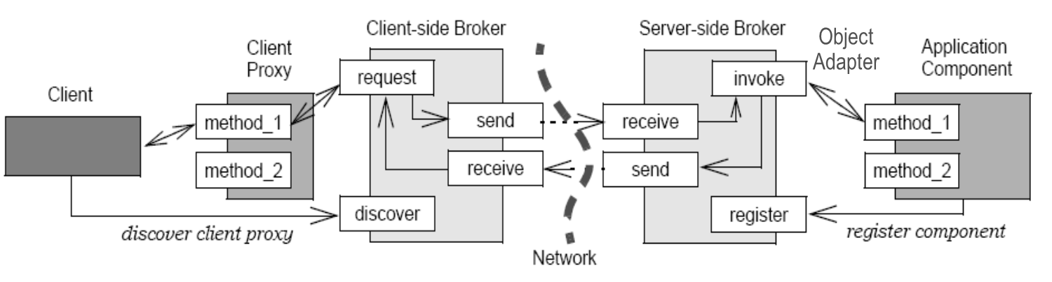
Topics Covered in this Part of the Module
Summarize history & contents of
Design Patterns: Elements of Reusable Software
Commonly known as the “Gang of Four” (GoF) book
Pattern-Oriented Software Architecture: A System of Patterns
Commonly known as “POSA1” book
Example of GoF & POSA1 patterns applied in the context of Android
Proxy
Broker

Slide 46
Motivating Example: Android App
The app Activity directs a Service to download images from a web server
The Service caches the images locally in external memory files managed by a Content Provider
Image URI is returned to Activity & displayed
Activity & Service interact via the Android Binder IPC mechanism
1: Activity calls downloadImage() with image URL
Download Service
2: Sends GET request to web server
3: Stores downloaded image in filesystem & metadata in Content Provider
4. Returns image URI back to Activity
5: Activity displays image
Image Metadata Content Provider
Image Files
Showcase use of the Broker pattern
See www.dre.vanderbilt.edu/~schmidt/cs282 for info on this app

Slide 47
Challenge: Isolating Communication Concerns
Context
A system that consists of multiple (potentially) remote objects that interact synchronously or asynchronously
DownloadActivity Process
DownloadService Process
Android’s Binder provides a high performance IPC mechanism for in-process & cross-process calls

Slide 48
Challenge: Isolating Communication Concerns
Context
A system that consists of multiple (potentially) remote objects that interact synchronously or asynchronously
Problems
App developers shouldn‘t need to handle
Low-level message passing, which is fraught with accidental complexity
DownloadActivity Process
DownloadService Process
Android’s Binder provides a high performance IPC mechanism for in-process & cross-process calls

Slide 49
Challenge: Isolating Communication Concerns
Context
A system that consists of multiple (potentially) remote objects that interact synchronously or asynchronously
Problems
App developers shouldn‘t need to handle
Low-level message passing, which is fraught with accidental complexity
Networked computing diversity
e.g., heterogeneous languages, operating systems, protocols, hareware, etc.
DownloadActivity Process
DownloadService Process
Android’s Binder provides a high performance IPC mechanism for in-process & cross-process calls

Slide 50
Challenge: Isolating Communication Concerns
Context
A system that consists of multiple (potentially) remote objects that interact synchronously or asynchronously
Problems
App developers shouldn‘t need to handle
Low-level message passing, which is fraught with accidental complexity
Networked computing diversity
e.g., heterogeneous languages, operating systems, protocols, hareware, etc.
Inherent networking complexities
e.g., partial failures, security mechanisms, latency, etc.
DownloadActivity Process
DownloadService Process
Android’s Binder provides a high performance IPC mechanism for in-process & cross-process calls
See www.dre.vanderbilt.edu/~schmidt/comm-foreword.html for more info

Slide 51
Use a Broker to Handle Communication Concerns
Solution
Separate system communication functionality from app functionality by providing a broker that isolates communication-related concerns
Download Activity
Broker
RemoteObject
IPC mechanisms
methods

Slide 52
Use a Broker to Handle Communication Concerns
Solution
Separate system communication functionality from app functionality by providing a broker that isolates communication-related concerns
e.g., one way to implement this in Android
A Service implements an Binder object that a client can’t accessible directly since it may reside in different process
Download Activity
Proxy
BinderObject
methods
methods
Broker
Stub
Binder IPC mechanisms
methods

Slide 53
Use a Broker to Handle Communication Concerns
Solution
Separate system communication functionality from app functionality by providing a broker that isolates communication-related concerns
e.g., one way to implement this in Android
A Service implements an Binder object that a client can’t accessible directly since it may reside in different process
Clients call a method on the proxy, which uses the Android Binder IPC mechanism (broker) to communicate with the object across process boundaries
Download Activity
Proxy
BinderObject
methods
methods
Broker
Stub
Binder IPC mechanisms
methods

Slide 54
Use a Broker to Handle Communication Concerns
Solution
Separate system communication functionality from app functionality by providing a broker that isolates communication-related concerns
e.g., one way to implement this in Android
A Service implements an Binder object that a client can’t accessible directly since it may reside in different process
Clients call a method on the proxy, which uses the Android Binder IPC mechanism (broker) to communicate with the object across process boundaries
The Binder IPC mechanisms use a stub to upcall a method to the object
Download Activity
Proxy
BinderObject
methods
methods
Broker
Stub
Binder IPC mechanisms
methods
Android Binder uses the Proxy pattern & supports sync & async communication

Slide 55
Broker POSA1 Architectural Pattern
Intent
Connect clients with remote objects by mediating invocations from clients to remote objects, while encapsulating the details of IPC or network communication
Applicability
Apps need capabilities to support (potentially) remote communication, provide location transparency, handle faults, manage end-to-end QoS, & encapsulate low-level system details
Dynamics
Object Adapter

Slide 56
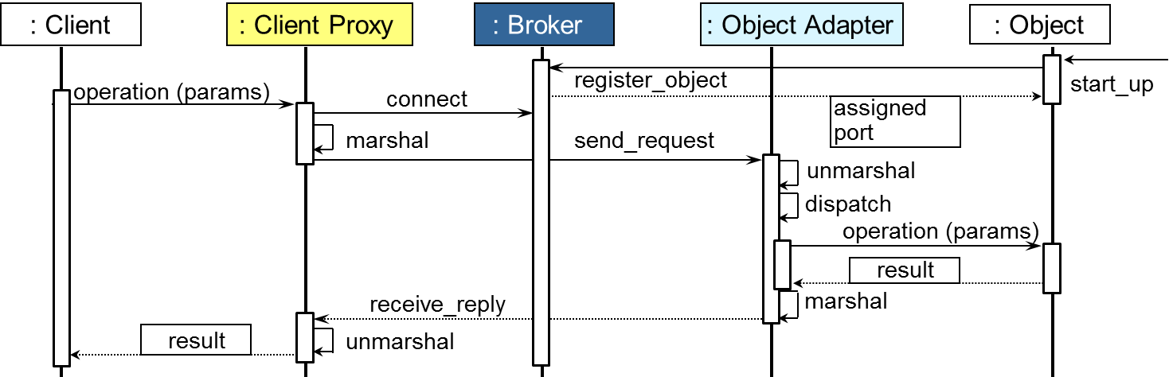
Broker POSA1 Architectural Pattern
Intent
Connect clients with remote objects by mediating invocations from clients to remote objects, while encapsulating the details of IPC or network communication
Applicability
Apps need capabilities to support (potentially) remote communication, provide location transparency, handle faults, manage end-to-end QoS, & encapsulate low-level system details
Dynamics

Slide 57
Broker POSA1 Architectural Pattern
Android Example in Java
(Some) steps involved in using Android Binder implementation of the Broker pattern
DownloadActivity Process
DownloadService Process
DownloadActivity
6: Call the method downloadImage() via Proxy
DownloadService
7: Stub dispatches to method & returns result
mDownloader
mDownloadBinder
5: Assign Proxy to local variable
1: Bind to Download Service
2: Start Download Service process if it’s not already running
3: Return reference to object that implements the IDownloadImage interface
bindService()
onBind()
ServiceConnection
IDownloadImage
onServiceConnected()
4: Downcast to Proxy
downloadImage()
Binder IPC Mechanism
Other patterns are involved here: Proxy, Activator, Adapter, etc.

Slide 58
Broker POSA1 Architectural Pattern
Android Example in Java
(Portion of) the implementation of the DownloadActivity
public class DownloadActivity extends Activity {
IDownloadImage mDownloader;
...
private ServiceConnection conn = new ServiceConnection() {
public void onServiceConnected(ComponentName name, IBinder iService) {
mDownloader = IDownloadImage.Stub.asInterface(iService);
... }
public void download(String url) {
...
String pathName = mDownloader.downloadImage(url);
...
}
The proxy object
Callback hook that downcasts to proxy
Call remote method via proxy
App use of IDownloadImage object is isolated from communication concerns

Slide 59
Broker POSA1 Architectural Pattern
Android Example in Java
(Portion of) the implementation of the DownloadService & the IDownloadImage object
public class DownloadService extends Service {
...
private final IDownloadImage.Stub mDownloadBinder =
new IDownloadImage.Stub() {
public String downloadImage(String urlValue) throws RemoteException {
...
} };
public IBinder onBind(Intent intent){ return mDownloadBinder; }
}
Downloads file from specified url & returns location of downloaded file in a synchronous call
Return reference to object implementing IDownloadImage
The IDownloadImage implementation is isolated from communication concerns

Slide 60
Broker POSA1 Architectural Pattern
CORBA Example
(Some) steps involved in using a CORBA implementation of the Broker pattern
6: Convert message to method on object implementation
1: Call method
6: Demultiplex message to destination interface
2: Convert method to encoded message
5: Demultiplex message to destination object
3: Send message to remote server
4: Receive message from client
CORBA shields apps from diverse languages, operating systems, networks, etc.

Slide 61
Broker POSA1 Architectural Pattern
Consequences
+ Location independence
+ Separation of concerns
+ Portability, modularity, reusability, etc.
Additional time & space overhead
May complicate debugging & testing
Implementation
Co-location optimizations
Synchrony & asynchrony
Pluggable protocols
Strategizing concurrency, synchronization, demuxing, connection management , fault tolerance, & security mechanisms, etc.
Some Known Uses
Distributed object computing middelware
e.g., OMG Common Object Request Broker Architecture (CORBA) & Sun Java Remote Method Invocation (RMI)
Local RPC systems on smartphones
e.g., Android Binder
Broker Revisited:www.kircher-schwanninger.de/michael/publications/BrokerRevisited.pdf

Slide 62


Summary
The Broker pattern is widely used in concurrent & networked software
Many open-source brokers available
e.g., TAO in C++ (www.dre.vanderbit.edu/TAO) & JacORB in Java (www.jacorb.org)
Notes:
Doug, fix this!

Slide 63
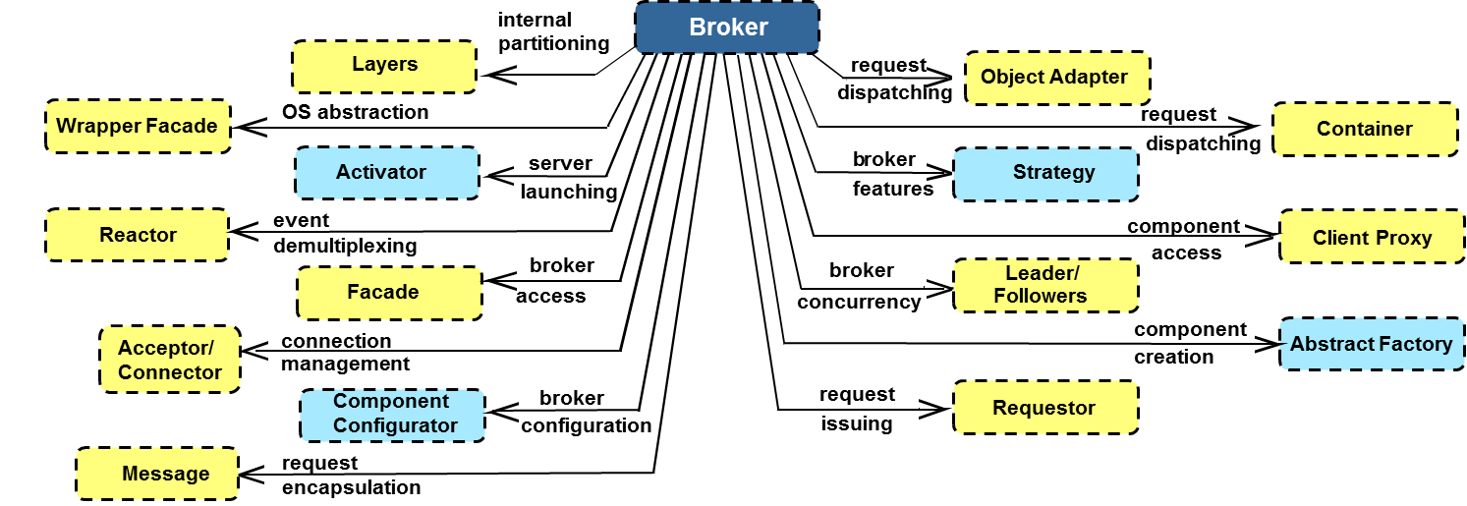
Summary
The Broker pattern is widely used in concurrent & networked software
Many open-source brokers available
Broker is more than an architecture pattern, however, it’s actually a pattern language that is composed of over a dozen patterns
www.voelter.de/publications/books-rem.html has pattern language for Broker
Notes:
Doug, fix this!

Slide 64
GoF & POSA1 Pattern Examples: Part 4
Douglas C. Schmidt
d.schmidt@vanderbilt.edu
www.dre.vanderbilt.edu/~schmidt
Professor of Computer Science
Institute for Software Integrated Systems Vanderbilt University Nashville, Tennessee, USA

Slide 65
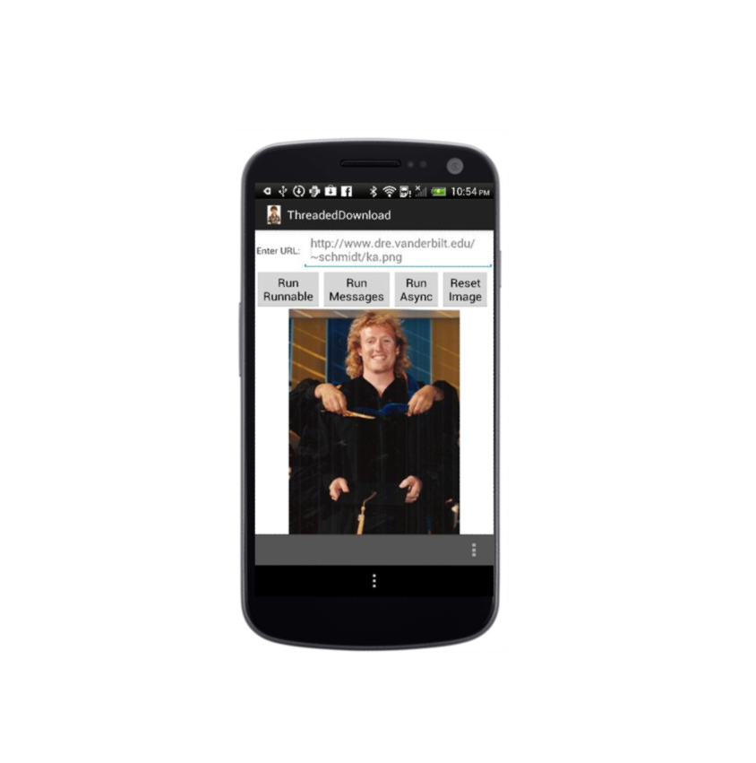
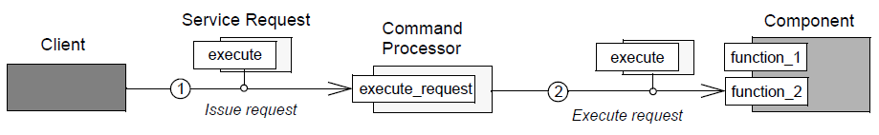
Topics Covered in this Part of the Module
Summarize history & contents of
Design Patterns: Elements of Reusable Software
Commonly known as the “Gang of Four” (GoF) book
Pattern-Oriented Software Architecture: A System of Patterns
Commonly known as “POSA1” book
Example of GoF & POSA1 patterns applied in the context of Android
Proxy
Broker
Command Processor

Slide 66
Motivating Example: Android App
The app Activity directs a Service to download images from a web server
The Service caches the images locally in external memory files managed by a Content Provider
Image URI is returned to Activity & displayed
Activity & Service interact via the Android Binder IPC mechanism
1: Activity calls downloadImage() with image URL
Download Service
2: Sends GET request to web server
3: Stores downloaded image in filesystem & metadata in Content Provider
4. Returns image URI back to Activity
5: Activity displays image
Image Metadata Content Provider
Image Files
Showcase use of Command Processor pattern
See www.dre.vanderbilt.edu/~schmidt/cs282 for info on this app

Slide 67
Challenge: Avoiding Blocking Calls in UI Thread
Context
Synchronous method calls in the Broker pattern can block client for extended periods
e.g., the downloadImage() call will block while the Service downloads the image
DownloadActivity Process
1: Activity makes blocking call
DownloadService Process
Notes:
Nimbuzz On Android - Free MMS, http://www.flickr.com/photos/9078261@N07/4095879656/

Slide 68
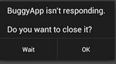
Challenge: Avoiding Blocking Calls in UI Thread
Context
Synchronous method calls in the Broker pattern can block client for extended periods
e.g., the downloadImage() call will block while the Service downloads the image
Problems
Android generates an “Application Not Responding” (ANR) dialog if an app doesn’t respond to user input within a short time (~3-5 seconds)
Calling a potentially lengthy operation like downloadImage() in the main thread can therefore be problematic
DownloadActivity Process
1: Activity makes blocking call
DownloadService Process
See developer.android.com/training/articles/perf-anr.html for more on ANRs
Notes:
Nimbuzz On Android - Free MMS, http://www.flickr.com/photos/9078261@N07/4095879656/

Slide 69
Execute Long-running Calls as Commands
Solution
Create a command processor that separates a request to download an image from service executing request
Download Activity
Download Service
Command Processor
onHandleIntent
startService

Slide 70
Execute Long-running Calls as Commands
Solution
Create a command processor that separates a request to download an image from service executing request
e.g., one way to implement in Android
Implement a DownloadService that inherits from Android’s IntentService
Download Activity
Download Service
Context
onHandleIntent
startService
Activity Manager Service
startService
See developer.android.com/reference/android/app/IntentService.html for more

Slide 71
Execute Long-running Calls as Commands
Solution
Create a command processor that separates a request to download an image from service executing request
e.g., one way to implement in Android
Implement a DownloadService that inherits from Android’s IntentService
Activity creates Intent command designating DownloadService as target
Add URL & callback Messenger as “extras”
Download Activity
Download Service
Context
onHandleIntent
startService
Activity Manager Service
startService
See developer.android.com/reference/android/app/IntentService.html for more

Slide 72
Execute Long-running Calls as Commands
Solution
Create a command processor that separates a request to download an image from service executing request
e.g., one way to implement in Android
Implement a DownloadService that inherits from Android’s IntentService
Activity creates Intent command designating DownloadService as target
Add URL & callback Messenger as “extras”
Activity calls startService() with Intent
Download Activity
Download Service
Context
onHandleIntent
startService
Activity Manager Service
startService
See developer.android.com/reference/android/app/IntentService.html for more

Slide 73
Execute Long-running Calls as Commands
Solution
Create a command processor that separates a request to download an image from service executing request
e.g., one way to implement in Android
Implement a DownloadService that inherits from Android’s IntentService
Activity creates Intent command designating DownloadService as target
Add URL & callback Messenger as “extras”
Activity calls startService() with Intent
Activity Manager Service starts IntentService, which spawns internal thread
Download Activity
Download Service
Context
onHandleIntent
startService
Activity Manager Service
startService
See developer.android.com/reference/android/app/IntentService.html for more

Slide 74
Execute Long-running Calls as Commands
Solution
Create a command processor that separates a request to download an image from service executing request
e.g., one way to implement in Android
Implement a DownloadService that inherits from Android’s IntentService
Activity creates Intent command designating DownloadService as target
Add URL & callback Messenger as “extras”
Activity calls startService() with Intent
Activity Manager Service starts IntentService, which spawns internal thread
IntentService calls onHandleIntent() to download image in separate thread
Download Activity
Download Service
Context
onHandleIntent
startService
Activity Manager Service
startService
See developer.android.com/reference/android/app/IntentService.html for more

Slide 75
Command Processor POSA1 Design Pattern
GoF book contains description of similar Command pattern
Intent
Encapsulate the request for a service as a command object
Applicability
Specify, queue, & execute service requests at different times
Ensure service enhancements don’t break existing code
Implement additional capabilities (such as undo/redo & persistence) consistently for all requests to a service
Structure & Dynamics
wiki.hsr.ch/APF/files/CommandProcessor.pdf has more on Command Processor

Slide 76
Command Processor POSA1 Design Pattern
Android Example in Java
(Some) steps involved in the Android implementation of Command Processor pattern
DownloadActivity Process
DownloadService Process
DownloadActivity
DownloadService
5: Return URI
mMessenger
onHandleIntent()
1: Sent Intent to Activity Manager Service
4: Download image & reply via Messenger
startService()
ServiceConnection
2: Activity Manager Service starts the Download Service if it’s not already running
3: IntentService base class queues the Intent & calls onHandleIntent(), which runs in a separate thread
onServiceConnected()
Activity Manager Service
Other patterns are involved here: Activator, Messaging, Result Callback, etc.

Slide 77
Command Processor POSA1 Design Pattern
Android Example in Java
(Portion of) the DownloadActivity implemented using the Command Processor pattern
public void runDownloadImage(View view) {
URL url = new URL(image_url.getText().toString())
Intent intent = new Intent(this, DownloadService.class);
intent.putExtra(DownloadService.MESSENGER,
new Messenger(handler))
intent.putExtra(DownloadService.URL, url);
startService(intent);
}
Make Intent “command”
Issue request to command processor
This code runs in the DownloadActivity process

Slide 78
Command Processor POSA1 Design Pattern
Android Example in Java
(Portion of) the DownloadService implemented using the Command Processor pattern
public class DownloadService extends IntentService { ...
protected void onHandleIntent(Intent intent) {
Bundle extras = intent.getExtras();
URL url = (URL)extras.get(URL);
Messenger messender (Messenger)extras.get(MESSANGER);
// Download image at designated URL & send // reply back to Activity via messenger callback
downloadImage(url, messenger);
}
}
Command processor executes the request
This code runs in a thread in the DownloadService process

Slide 79
Command Processor POSA1 Design Pattern
Consequences
Allow different users to work with service in different ways via commands
Client isn’t blocked for duration of command processing
Additional programming to handle info passed with commands (cf. Broker)
Supporting two-way operations requires additional patterns
Implementation
Statically-typed vs. dynamically-typed commands
Concurrency & queueing model(s)
Support for persistence & transactions
Known Uses
Android IntentService
Many UI toolkits
InterViews, ET++, MacApp, etc.
Interpreters for command-line shells

Slide 80
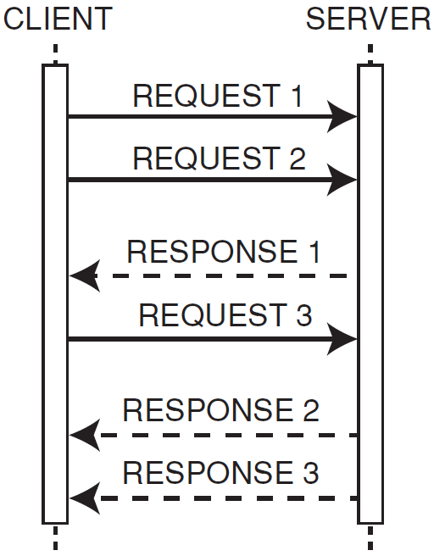
Summary
The Command Processor pattern provides a relatively straightforward means for passing commands asynchronously between threads and/or processes in concurrent & networked software
Command Processor & Broker are “pattern complements”

Slide 81
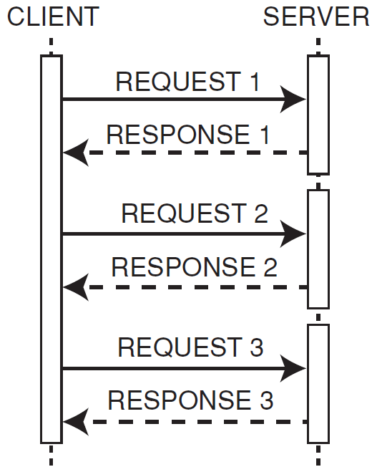
Summary
Command Processor provides a relatively straightforward architecture for passing commands asynchronously between threads and/or processes in concurrent & networked software
In contrast, many implementations of Broker use synchronous method invocations
Some brokers also support asynchronous method invocations
e.g., Android Binder & CORBA both support asynchronous method invocations
Command Processor & Broker are “pattern complements”

Slide 82
Summary
Command Processor provides a relatively straightforward architecture for passing commands asynchronously between threads and/or processes in concurrent & networked software
In contrast, many implementations of Broker use synchronous method invocations
Some brokers also support asynchronous method invocations
e.g., Android Binder & CORBA both support asynchronous method invocations
It’s the responsibility of software architects to understand the trade-offs between these patterns
?
Command Processor & Broker are “pattern complements”

Slide 83
GoF & POSA1 Pattern Examples: Part 5
Douglas C. Schmidt
d.schmidt@vanderbilt.edu
www.dre.vanderbilt.edu/~schmidt
Professor of Computer Science
Institute for Software Integrated Systems Vanderbilt University Nashville, Tennessee, USA

Slide 84
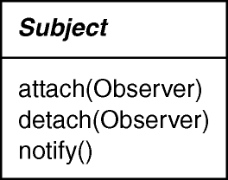
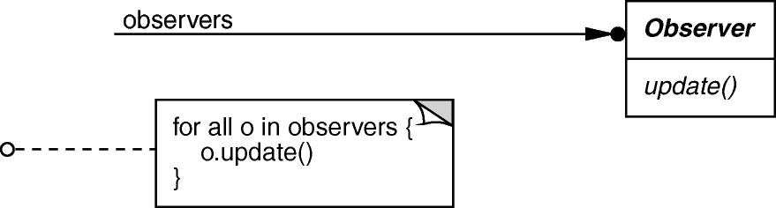
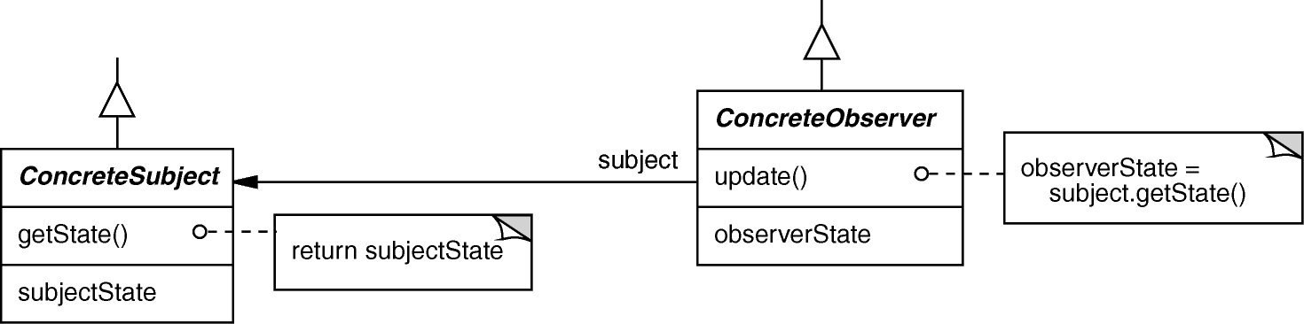
Topics Covered in this Part of the Module
Summarize history & contents of
Design Patterns: Elements of Reusable Software
Commonly known as the “Gang of Four” (GoF) book
Pattern-Oriented Software Architecture: A System of Patterns
Commonly known as “POSA1” book
Example of GoF & POSA1 patterns applied in the context of Android
Proxy
Broker
Command Processor
Observer

Slide 85
Motivating Example: Android App
The app Activity directs a Service to download images from a web server
The Service caches the images locally in external memory files managed by a Content Provider
Image URI is returned to Activity & displayed
Activity & Service interact via the Android Binder IPC mechanism
1: Activity calls downloadImage() with image URL
Download Service
2: Sends GET request to web server
3: Stores downloaded image in filesystem & metadata in Content Provider
4. Returns image URI back to Activity
5: Activity displays image
Image Metadata Content Provider
Image Files
Showcase use of Observer pattern (for infrastructure)
See www.dre.vanderbilt.edu/~schmidt/cs282 for info on this app

Slide 86
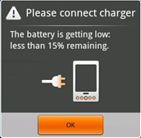
Challenge: Efficiently Maintain Consistency Between Related Objects without Tight Coupling
Context
Smartphone platforms keep track of system-related status info that is of interest to apps
e.g., Android tracks & report low battery status
Notes:
Nimbuzz On Android - Free MMS, http://www.flickr.com/photos/9078261@N07/4095879656/

Slide 87
Challenge: Efficiently Maintain Consistency Between Related Objects without Tight Coupling
Context
Smartphone platforms keep track of system-related status info that is of interest to apps
e.g., Android & iPhone track & report low battery status
Problems
Multiple apps/services may be interested in system status info
Coupling status info w/app presentation violates modularity
Apps polling for changes to status information is inefficient
Phone App
System Server
?
?
Battery Service
Notes:
Nimbuzz On Android - Free MMS, http://www.flickr.com/photos/9078261@N07/4095879656/

Slide 88
Updating Dependents When a Subject Changes
Solution
Automatically notify all apps that depend on system status info when it changes
Phone App
System Server
Notifier
Battery Service

Slide 89
Updating Dependents When a Subject Changes
Solution
Automatically notify all apps that depend on system status info when it changes
e.g., how this is done in Android
Define a BroadcastReceiver whose onReceive() hook method is called when a change occurs to system status info
Broadcast Receivers
Phone App
System Server

Slide 90
Updating Dependents When a Subject Changes
Solution
Automatically notify all apps that depend on system status info when it changes
e.g., how this is done in Android
Define a BroadcastReceiver whose onReceive() hook method is called when a change occurs to system status info
Use registerReceiver() in an activity to attach BroadcastReceiver that’s called back when intent is broadcast
e.g., ACTION_BATTERY_LOW
Broadcast Receivers
Phone App
System Server
0: Call registerReceiver() with ACTION_ BATTERY_LOW intent filter
Activity Manager Service

Slide 91
Updating Dependents When a Subject Changes
Solution
Automatically notify all apps that depend on system status info when it changes
e.g., how this is done in Android
Define a BroadcastReceiver whose onReceive() hook method is called when a change occurs to system status info
Use registerReceiver() in an activity to attach BroadcastReceiver that’s called back when intent is broadcast
e.g., ACTION_BATTERY_LOW
BatteryService calls sendBroadcast() to tell BroadcastReceivers battery’s low
Broadcast Receivers
Phone App
System Server
2: onReceive() called back to report low battery
Activity Manager Service
1: Call sendBroadcast() when battery is low
Battery Service
Android also uses the Proxy & Broker patterns in this scenario

Slide 92
Observer GoF Object Behavioral
POSA1 book contains description of similar Publisher-Subscriber pattern
Intent
Define a one-to-many dependency between objects so that when one object changes state, all dependents are notified & updated
Applicability
An abstraction has two aspects, one dependent on the other
A change to one object requires changing untold others
An object should notify unknown other objects
Structure

Slide 93
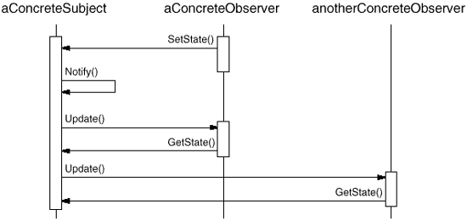
Observer GoF Object Behavioral
Intent
Define a one-to-many dependency between objects so that when one object changes state, all dependents are notified & updated
Applicability
An abstraction has two aspects, one dependent on the other
A change to one object requires changing untold others
An object should notify unknown other objects
Dynamics

Slide 94
Observer GoF Object Behavioral
Android Example in Java
Using Observer pattern to report low battery status on Android
StatusBarPolicy.java & PhoneApp.java
PhoneApp.java
Receive Intent
Register IntentFilters
class PhoneAppBroadcastReceiver extends BroadcastReceiver {
public void onReceive (Context context, Intent intent) {
... if (action.equals (Intent.ACTION_BATTERY_LOW)) notifier.sendBatteryLow(); ...
IntentFilter filter = new IntentFilter();
...
filter.addAction (Intent.ACTION_BATTERY_LOW);
...
mContext.registerReceiver (mIntentReceiver, filter);
BatteryService.java
Broadcast Intent
if (sendBatteryLow) {
statusIntent.setAction(Intent.ACTION_BATTERY_LOW);
mContext.sendBroadcast(statusIntent);
}

Slide 95
Observer GoF Object Behavioral
Consequences
Modularity: subject & observers may vary independently
Extensibility: can define/add any # of observers
Customizability: different observers offer different views of subject
Unexpected updates: observers don’t know about each other (notification storm)
Update overhead: too many irrelevant updates
Implementation
Subject-observer mapping
Dangling references 悬挂引用
Update protocols: the push & pull models
Adding filters to narrow interests efficiently
Known Uses
Many GUI toolkits
e.g., Smalltalk, MFC, InterViews, etc.
Smart phone event notification
e.g., Android Intents framework & Content Providers
Java Observer & Observable
See en.wikipedia.org/wiki/Observer_pattern for more on Observer pattern

Slide 96
Summary
GoF & POSA1 patterns promote
Reuse of recurring micro- architectures in current & networked software

Slide 97
Summary
GoF & POSA1 patterns promote
Reuse of recurring micro- architectures in current & networked software
A common vocabulary that helps teams communicate more effectively about design
Proxy
Broker
Observer
Command Processor
…

Slide 98
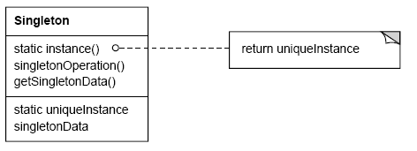
Summary
GoF & POSA1 patterns promote
Reuse of recurring micro- architectures in current & networked software
A common vocabulary that helps teams communicate more effectively about design
Many GoF & POSA1 patterns are relevant for concurrent & networked software
Apply some patterns carefully to avoid “surprises”..
If (uniqueInstance == 0)
uniqueInstance = new Singleton;
return uniqueInstance;
Singleton pattern

Slide 99


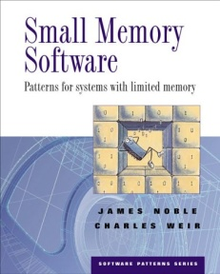

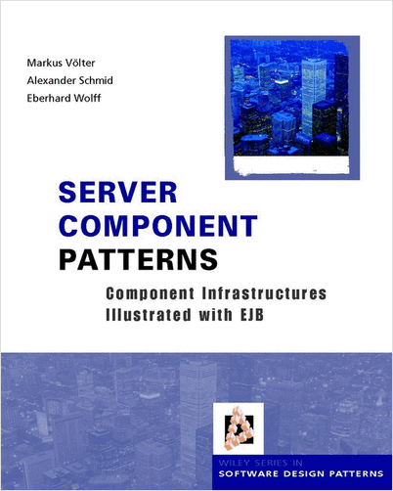
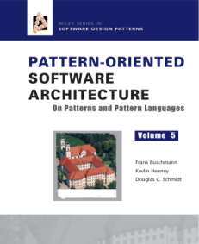



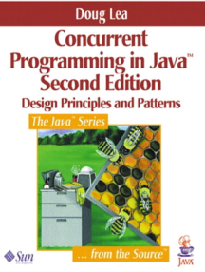
Summary
GoF & POSA1 patterns promote
Reuse of recurring micro- architectures in current & networked software
A common vocabulary that helps teams communicate more effectively about design
Many GoF & POSA1 patterns are relevant for concurrent & networked software
Apply some patterns carefully to avoid “surprises”..
There’s much more to patterns than just these two books, however!!!!
See www.dre.vanderbilt.edu/~schmidt/PDF/ieee-patterns.pdf for more info

